Slide 1
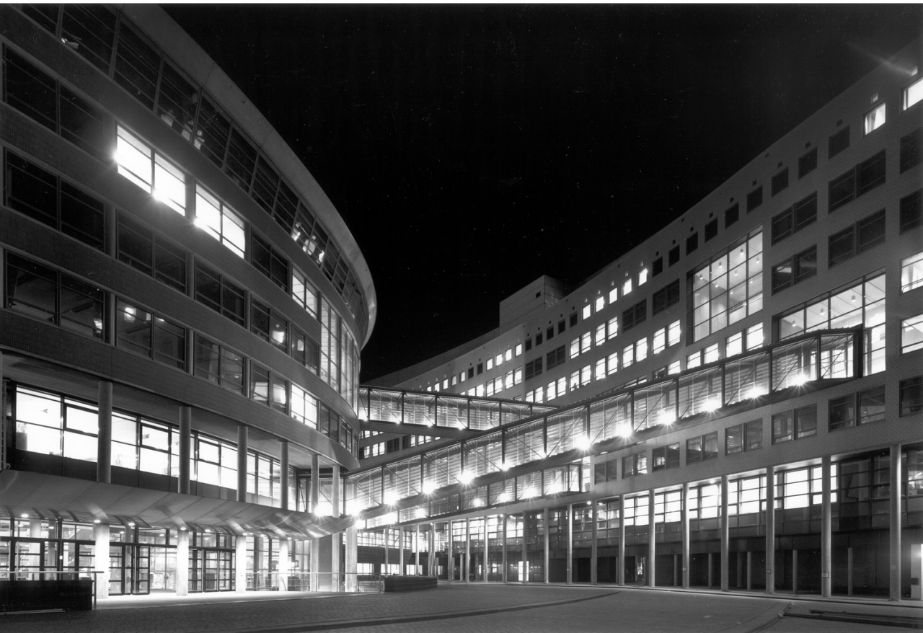



OPSCHALER
KB-74 Presentation
Megan Meezen​
Daan Boesten​
Brian de Keijzer​
Victor Gómez​
Victor García​
Pol de Visser​
​
07-12-2018

Slide 2
Introduction
The research goal: gas usage prediction on residential houses
Predict one week ahead
Predict with a hourly resolution
Use as less data as possible
Currently predicting on the aggregated level, so groups of houses instead of individual houses.
[1]

Slide 3
Paper - Prepare Data
Prepare data to use same conditions in every model:
Features used
Test-size (and of course Train)
Feature scaling
Dummy variables
[2]

Slide 4
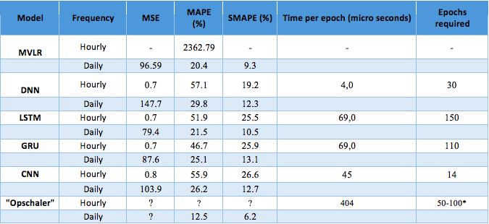
Paper - Results
[2]

Slide 5
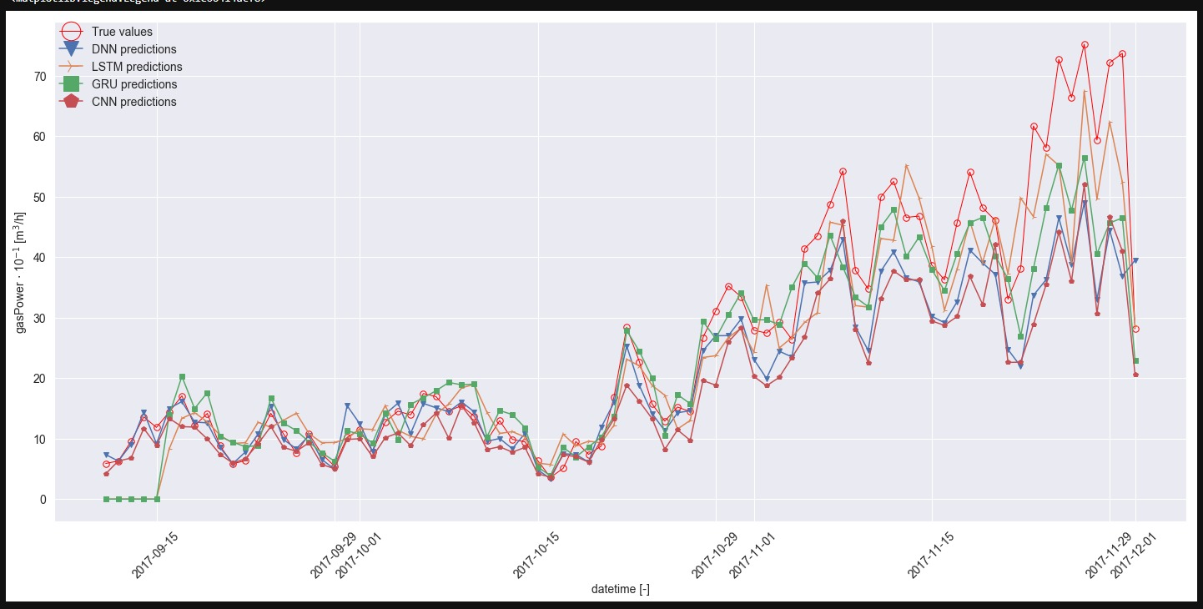
Paper - Results
[2]

Slide 6
Paper - Methodology
Introduction
Data selection
Dummy variables
Feature scaling
Data splitting
Models explanation
[2]

Slide 7
Paper - Future work
Introduction
Conclusions
[2]

Slide 8
Q&A
[24]

